Slide 1
Web Technologies: Introduction
ICT40120 Certificate IV in Information Technology (Programming)
Code | Title
ICTWEB441 | Produce basic client-side script
ICTWEB452 | Create a markup language document

Slide 2
Web Tech: Sessions
ICT40120 Certificate IV in Information Technology (Programming)
Code | Title
ICTWEB441 | Produce basic client-side script
ICTWEB452 | Create a markup language document

Slide 3
Sessions
A session is a component of study
Sessions may include:
Notes
Demonstrations
Challenges
Out of class activities

Slide 4
4: CSS3 Basics
ICT40120 Certificate IV in Information Technology (Programming)

Slide 5
What is CSS?
Cascading Style Sheets
Currently Release 3
CSS no longer has full releases
CSS3 is a collection of modules
Modules are added/edited/deprecated

Slide 6
What is CSS?
Gives the content style
Similar to taking a battered and worn table
And restoring it

Slide 7
What is CSS?
Style requires good semantic HTML
A poor HTML structure?
CSS is difficult to implement
CSS is much harder to maintain

Slide 8
What is CSS?
Three ways to implement CSS
Inline CSS
In file CSS
External CSS

Slide 9
Inline CSS
Bad practice for large sites
Often used for HTML eMail
Mail client limitations
Used for very special situations

Slide 10
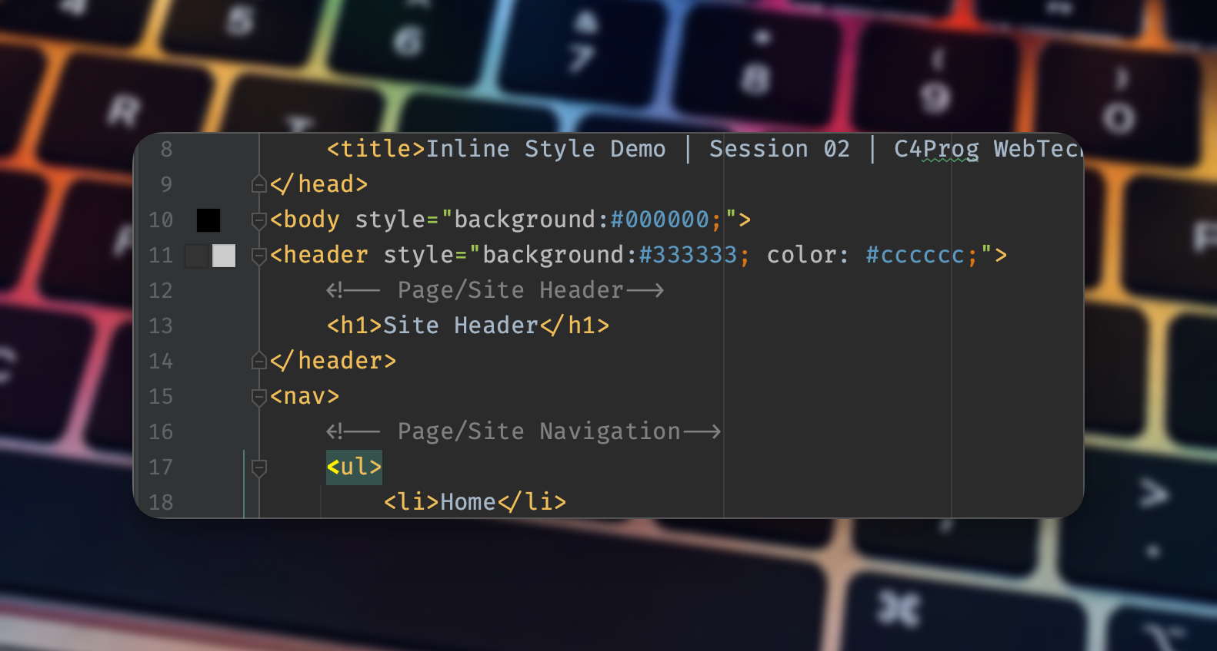
Inline CSS
Example

Slide 11
CSS in HTML File
Special situations
Enclosed in an HTML file in the HEAD
Uses the <style> … </style> element
Also very cumbersome to maintain

Slide 12
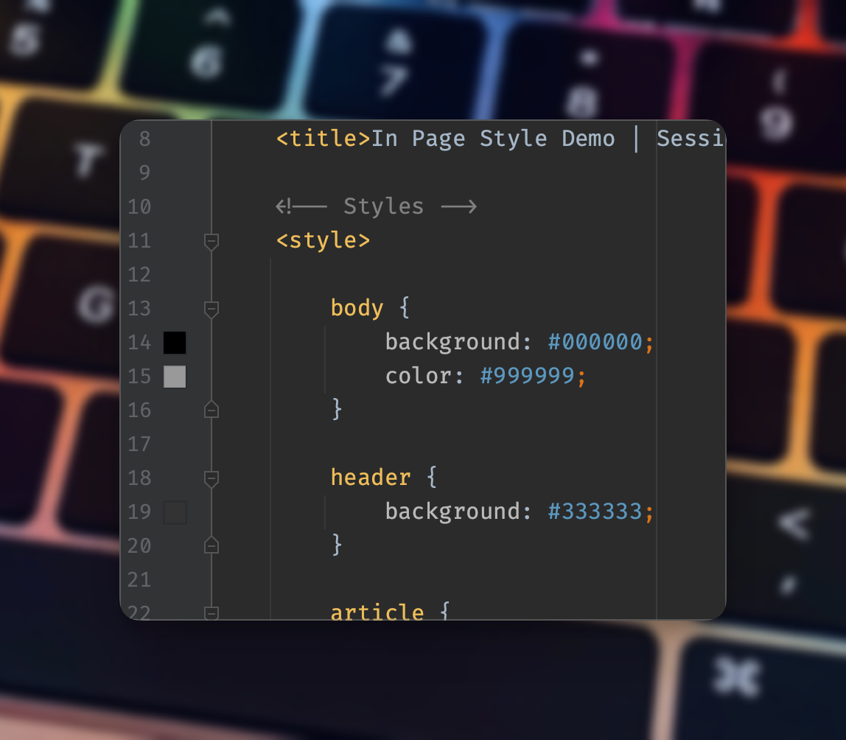
CSS in HTML File
Example

Slide 13
External CSS File
Best method
Reduces file sizes
Reduces redundancy
Improves site consistency
Much easier to maintain

Slide 14
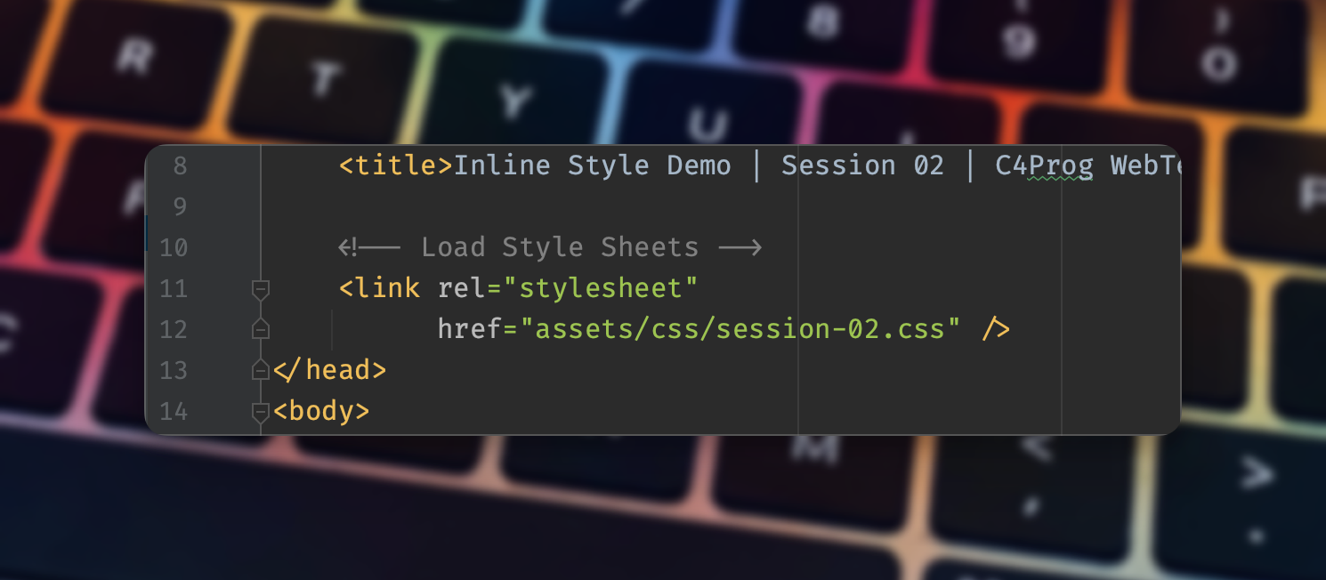
External CSS File
Example
the link to the external stylesheet

Slide 15
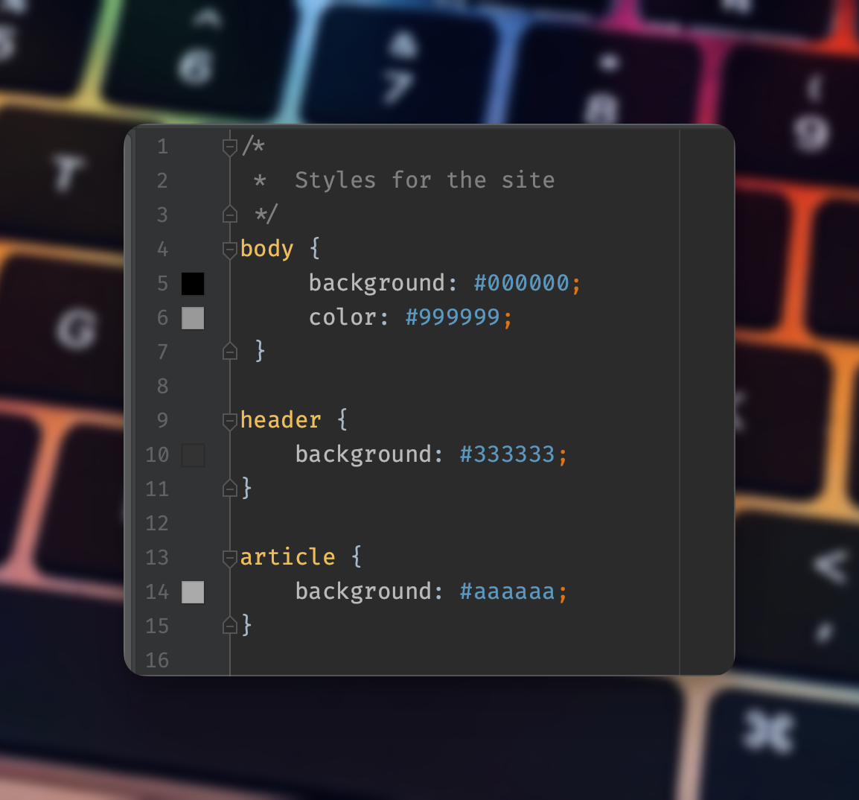
External CSS File
Example
the external stylesheet

Slide 16
CSS Reset
Why reset?
How to reset?
Examples of CSS Reset
We will use …

Slide 17
CSS Basics
Colour
Font Size

Slide 18
Box Model
The two versions
Why use the modern version

Slide 19
CSS Basics II
Border
Padding
Margin
TRouBLe mnemonic
T R B L
T R+L B
T+B R+L
TRBL

Slide 20
CSS Basics II
CSS Grid

Slide 21
CSS Basics II
CSS Flexbox

Slide 22
CSS Basics II
CSS Flexbox

Slide 23
🦆

